Slide 1

Deepdive Unit Testing in .NET
Day 3

Slide 2
Agenda Day 3
Check-in
Recap
BYOP (bring your own project)
Useful libraries
Books

Slide 3

Bring your own project

Slide 4

Useful libraries

Slide 5
Tired of writing unit tests? Stop writing code!

Slide 6
AutoMapper
Library to map/convert one object to another
https://github.com/AutoMapper/AutoMapper
https://automapper.readthedocs.io/en/stable/

Slide 7
AutoMapper
// Setup
Mapper.Initialize(cfg => {
cfg.CreateMap<Foo, FooDto>();
cfg.CreateMap<Bar, BarDto>();
});
// Mapping
var fooDto = Mapper.Map<FooDto>(foo);

Slide 8
FluentValidation
Write fluent validations for objects
https://github.com/JeremySkinner/FluentValidation
https://fluentvalidation.net/

Slide 9
FluentValidation
public class CustomerValidator: AbstractValidator<Customer> {
public CustomerValidator() {
RuleFor(x => x.Surname).NotEmpty();
RuleFor(x => x.Discount).NotEqual(0).When(x => x.HasDiscount);
RuleFor(x => x.Address).Length(20, 250);
RuleFor(x => x.Postcode).Must(BeAValidPostcode).WithMessage("Please specify a valid postcode");
}
private bool BeAValidPostcode(string postcode) {
// custom postcode validating logic goes here
}
}

Slide 10
FluentValidation
var customer = new Customer();
var validator = new CustomerValidator();
ValidationResult results = validator.Validate(customer);
bool success = results.IsValid;
IList<ValidationFailure> failures = results.Errors;

Slide 11

Books

Slide 12
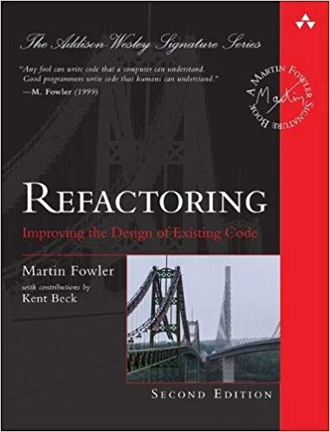
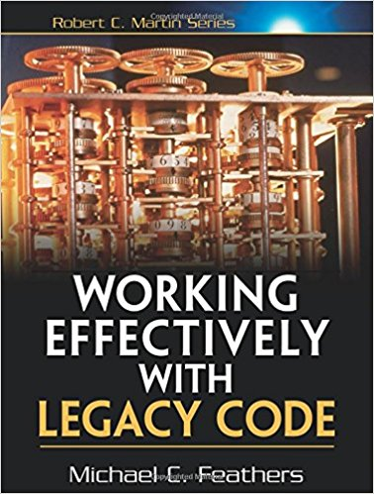
Books

Slide 13
Check out
What did you like best?
What could be improved?

Slide 14


